Slide 1
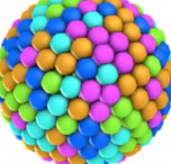
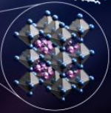
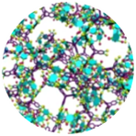
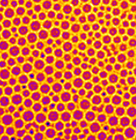
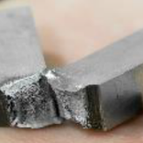
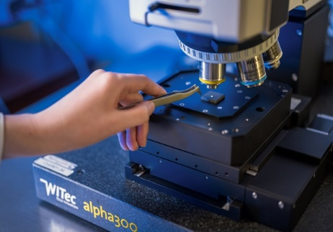
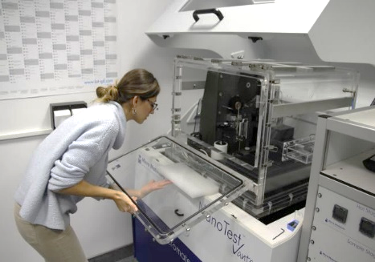
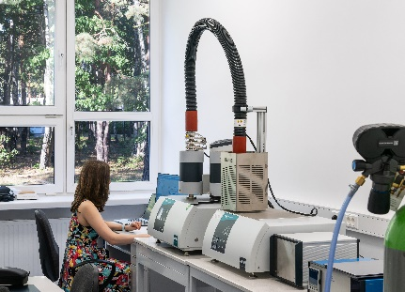
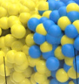
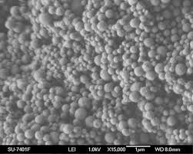





Cost Action EU-MACE
.
Building a new form of systemic research ecosystem around autonomous Materials Acceleration Platforms (MAPs) for advanced functional materials for sustainable energy technologies.
EU-MACE network offers:
Young Researchers ITC* conference grants
Dissemination Conference grants
Short Term Scientific Mission grants
Training schools & Incubation of future ERASMUS+ programme
Workshops/conference
Searchable database on MAPs and Experts
Build your network :
MAP to MAP
Materials Science Researchers (Discover MAPs)
Industries, SSDB experts, Device integration experts (MAP+ initiative)
Incubation of new MAPs
EU and International projects and platforms on advanced materials
.
Picutres provided by
Contact:
Action chair: sawako.nakamae@cea.fr (Saco)
Sci. Comm. Coord.: g.botton@eera-set.eu (Gloria)
ITC* Inclusiveness Target countries
Find us @ https://eu-mace.eu & LinkedIn: company/cost-action-eu-mace

